Slide 1
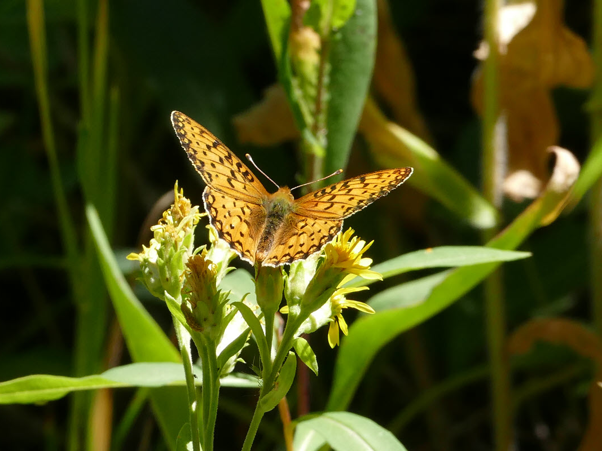

Welcome
This room has a hearing loop. For clear sounds, customized for your hearing aids or cochlear implants, switch to your telecoil program. If you don’t use hearing aids, you can borrow headphones and a receiver at no cost.

Slide 2

Welcome

Slide 3
To hear more clearly, our theater/place of worship/library/etc. has a hearing loop
Template courtesy of CenterForHearingAccess.org
For those with hearing aids and cochlear implants with telecoils
  Switch to your telecoil program (no equipment to borrow)
For those without hearing aids or without telecoils
  Borrow headphones and a receiver from (location) at no cost
(insert your logo)
Instructions:
Replace red font text with your information
Add your logo
Delete red boxes

