Slide 1
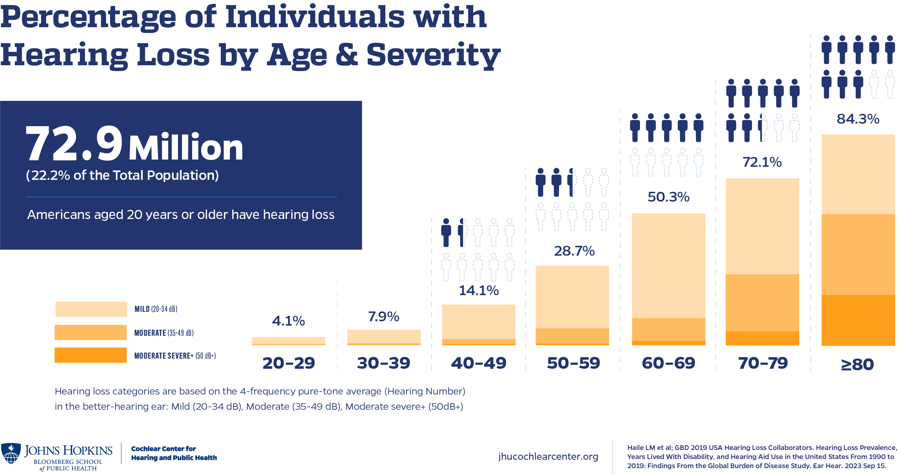
Hearing Loss Increases with Age
Template courtesy of CenterForHearingAccess.org
Add your logo
https://www.jhucochlearcenter.org/infographic-hearing-loss-prevalence-us
Approximately 870,000 to 1.16 M Coloradoans are deaf, hard of hearing, or deafblind (15-20%)
To communicate:
97.2% to 99% use oral communication
1% to 2.8% use sign language
Instructions:
Replace fuschia highlight with your state’s info
Delete red boxes

